Slide 1
HARDWARE DESIGN

Slide 2
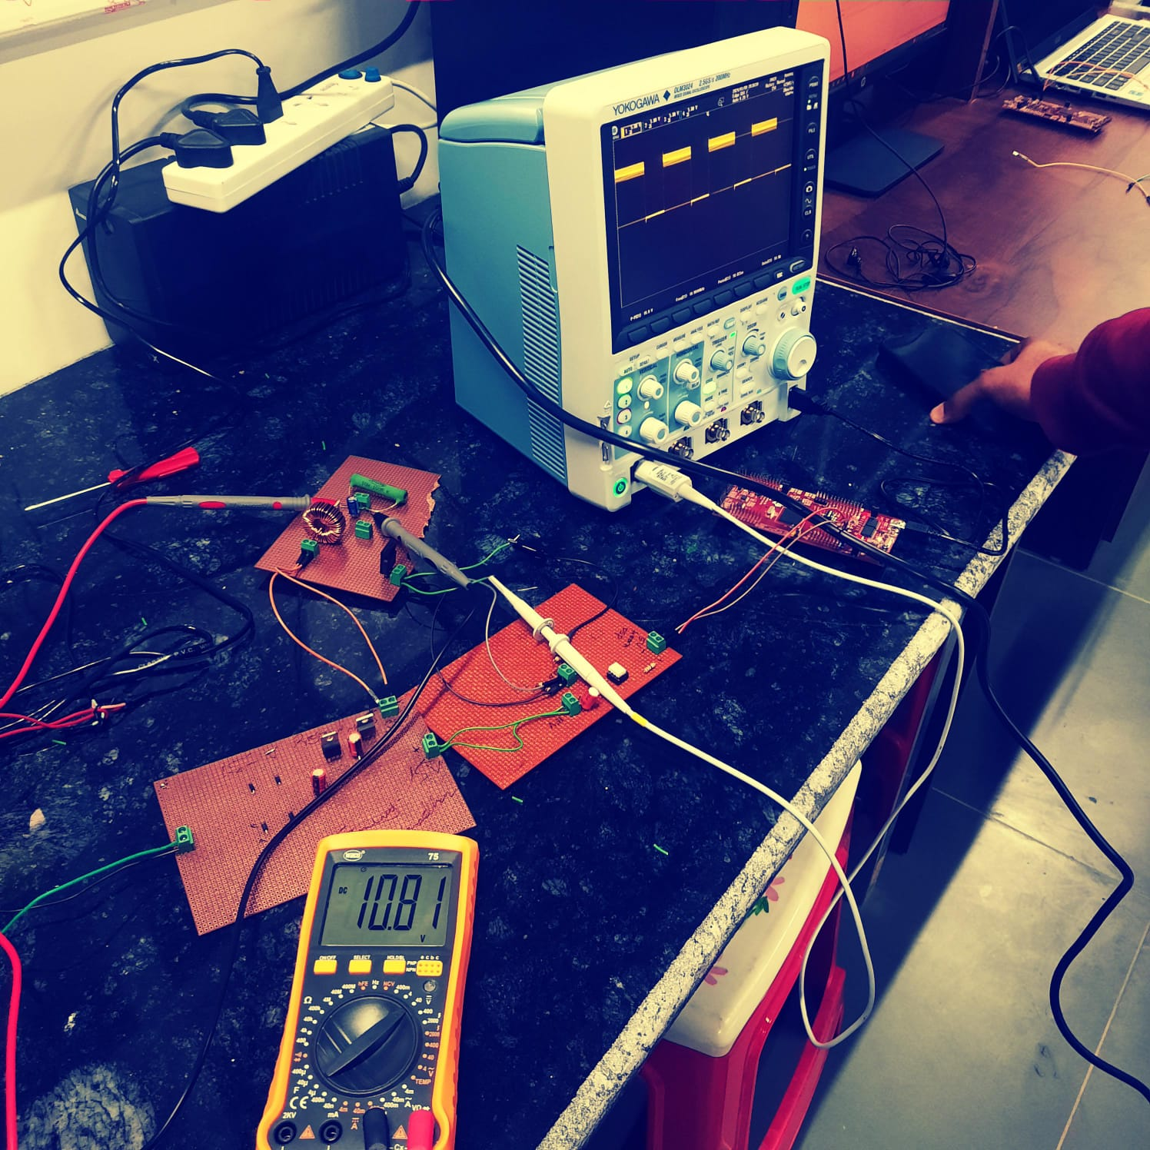
BOOST CONVERTER DESIGN
BOOST CONVERTER DESIGN
DSP (TMS320F28379D)
GATE DRIVER CICUIT
DC SUPPLY

Slide 3
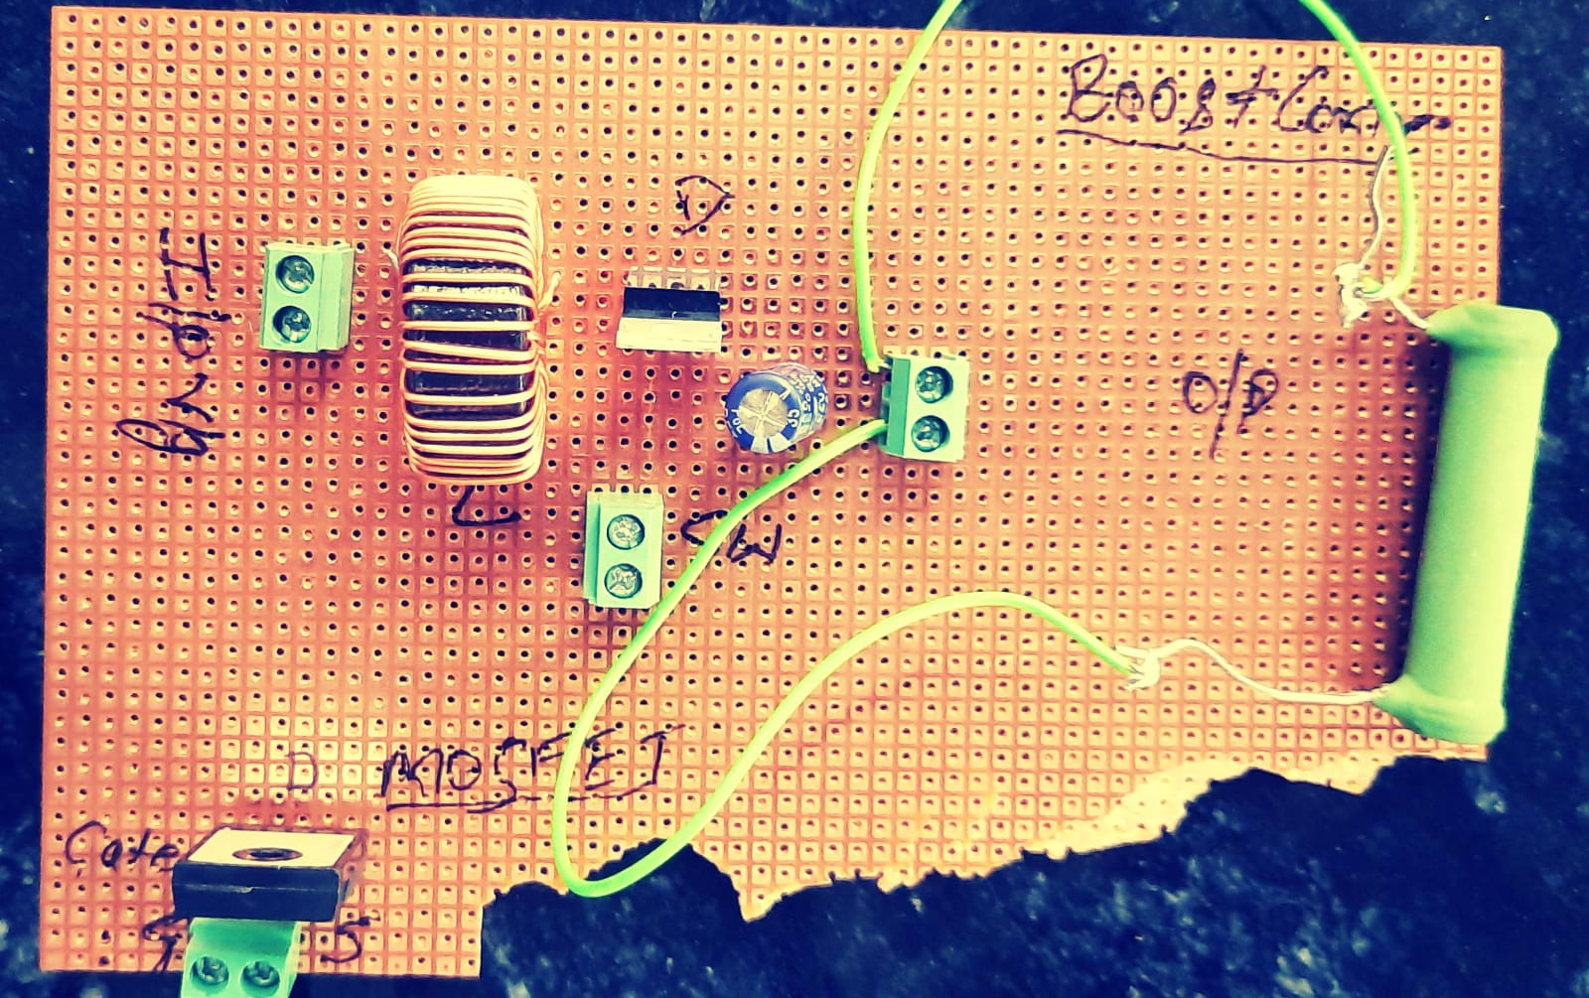
BOOST CONVERTER (DC/DC) CIRCUIT DESIGN
COMPONENTS
INDUCTOR (470uh)
MOSFET (IRF420)
2 PIN CONNECTORS
CAPACITOR ACROSS LOAD
LOAD RESISTANCE
INPUT SUPPLY
GATE DRIVER
DSP MICRO CONTROLLER (TMS320F28379D)

Slide 4
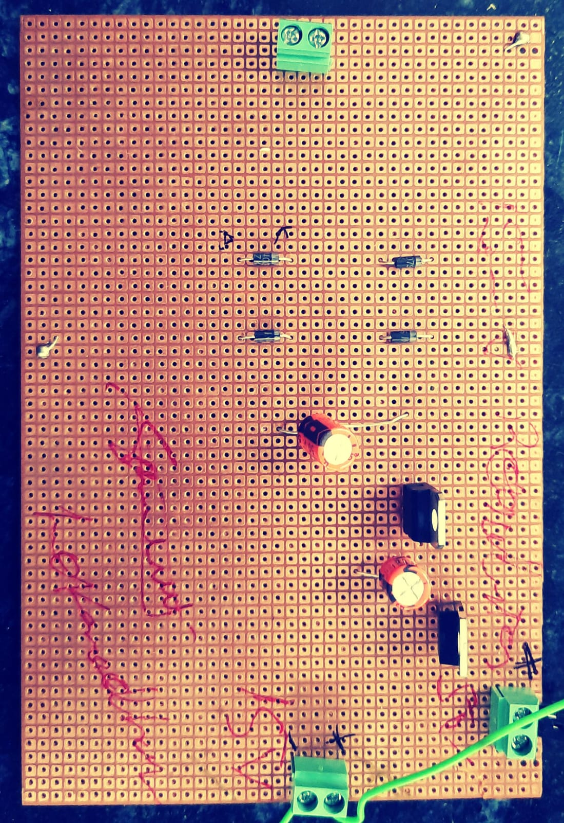
15V AND 5V DESIGN OF DC SUPPLY
COMPONENTS:
AC/AC MID POINT TRANSFORMERS
IN4007 DIODE
CAPACITOR
VOLTAGE REGULATOR LM7805, LM7815

Slide 5
GATE DRIVER CICUIT DESIGN
COMPONENTS
GATE DRIVER CIRCUIT TLP250 (GATE DRIVER)
GATE RESISTANCE SELECTION (Rg)
Vcc SUPPLY FROM DC SUPPLY
INPUT 5V FROM DSP
CAPACITORS

